Slide 1
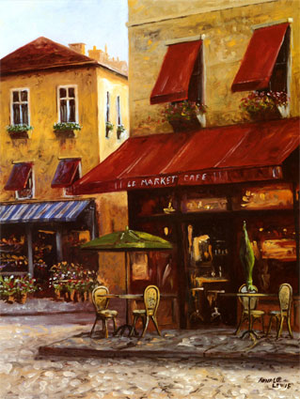
Mercredi, 6 mai
Au café
Learning objective:
to be able to say at least 8 foods you might order in a café.

Slide 2
Les Chiffres

Slide 5
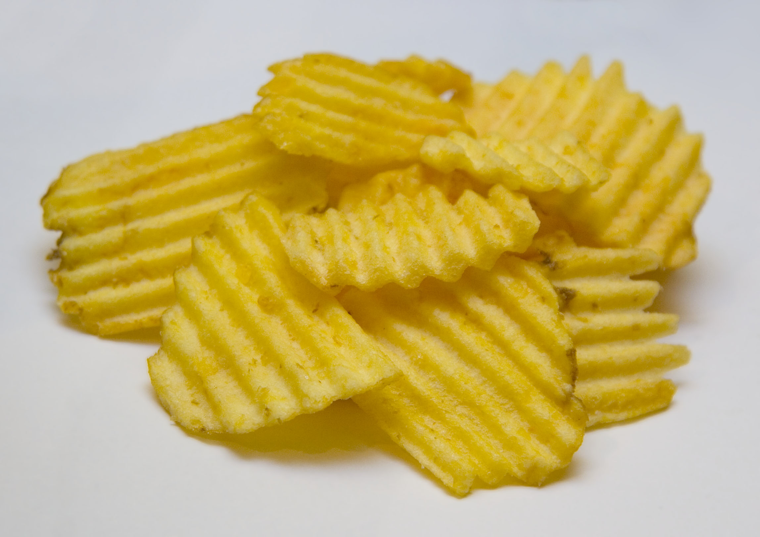

Slide 7
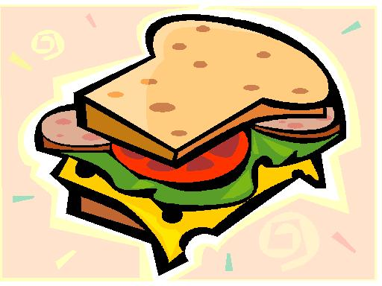

Slide 8
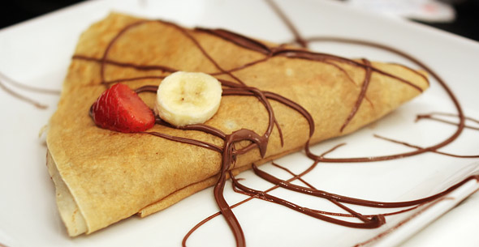

Slide 11
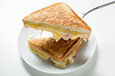

Slide 14
un hamburger

Slide 15
des pommes frites

Slide 16
des chips

Slide 17
une pizza

Slide 18
un sandwich

Slide 19
une crêpe

Slide 20
une omelette

Slide 21
un steak-frites

Slide 22
un croque-monsieur

Slide 23
du gâteau

Slide 24
une glace

Slide 25
Qu’est-ce que tu mange?
Je mange
un
une
des
du
hamburger
sandwich
croque-monsieur
steak-frites
omelette
pizza
crêpe
glace
frites
chips
gâteau

Slide 26

Dice game
Take it in turns to throw the dice – say the past participle that corresponds to the infinitive shown
e.g. if you throw a 1, you get ‘I eat some chips’. In French this is ‘je mange des frites’.
When you have finished, write down at least 3 of the sentences in French.

Slide 27


Slide 30
Learning objective
to be able to say at least 8 foods you might order in a café.
Mission impossible?

